Slide 1
AUTOMOTIVE INTELLIGENT SYSTEMS: TUNNEL RECOGNITION USING DEEP LEARNING TECHNIQUES
Radu galan

Slide 2
purpose
?
?
?
Introduction
State of the art
Architecture and implementation
Model selection and techniques
Results and conclusion
Short demo

Slide 3
introduction
Problem definition
Example
Motivation

Slide 4
Problem definition
We want to predict approaching infrastructure on the road (tunnels and bridges) from a moving point of view located on a vehicle and using sensors (especially the camera) present on the vehicle.

Slide 5
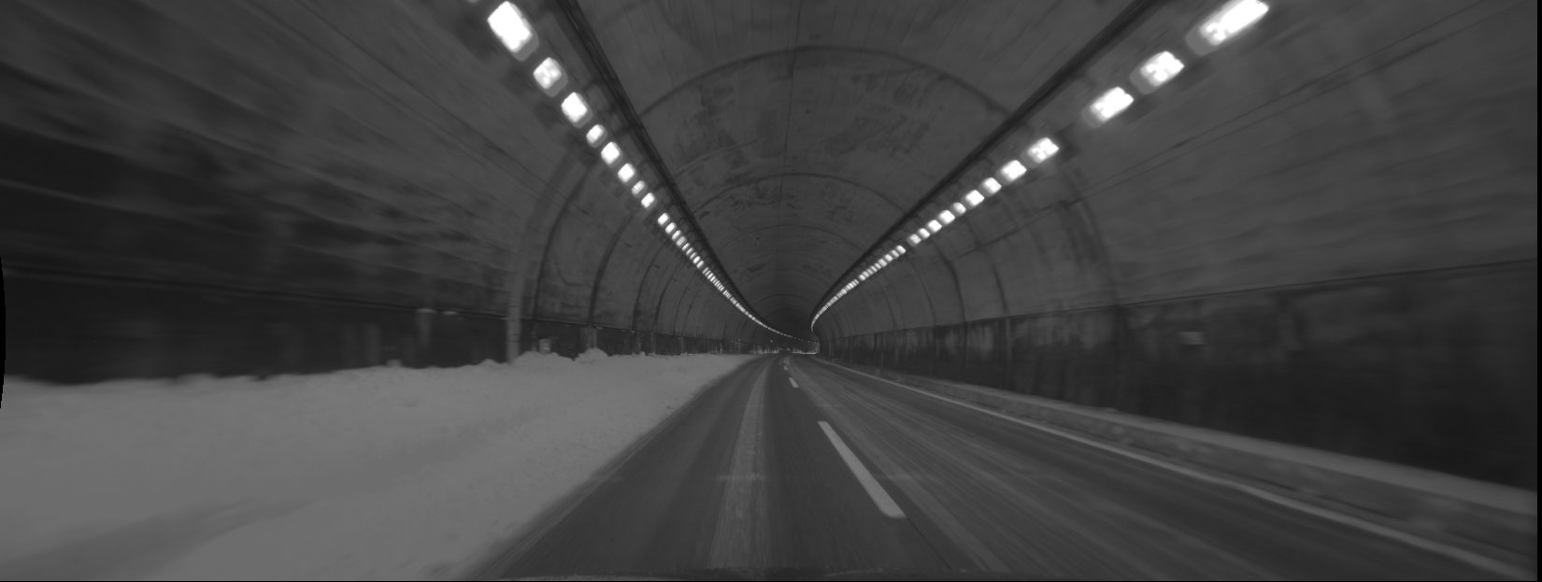
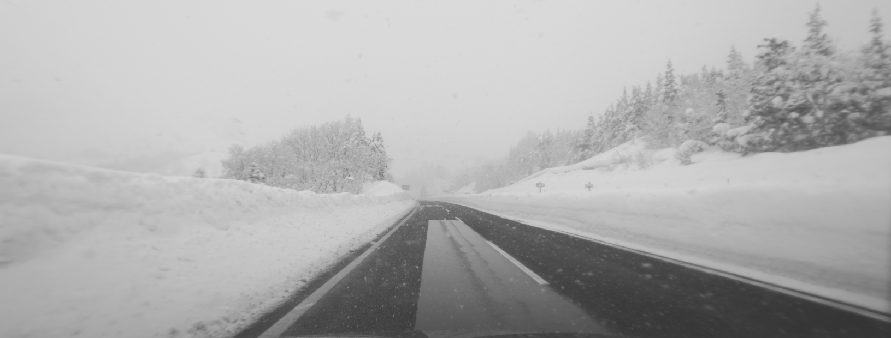
example
TUNNEL
Binary classification of images
NO TUNNEL

Slide 6


example
ENTRANCE
TUNNEL
INSIDE
Binary classification of images
Multi-class classification
of images
EXIT
NO TUNNEL

Slide 7







motivation
Sensor calibration
Internal ventilation
Automotive Auxiliary Systems
Headlights
Internal temperature
Windscreen wipers
Strategizing
Safety alerts
Notes:
In modern vehicles the computer on board has access to all the subsystems of the car.
How can we USE the tunnel information directly
-calibrating the camera, ultrasonic sensor, light sensor etc (camera blindness on sudden brightness changes)
-tunnel pollution, keep clean air inside
-lights on and well calibrated, not to point directly to other drivers and blind them
-adjust temperature to avoid dew/vapor inside the car and on the screens
-stop the windscreen for economy
-if we are talking about autonomous driving, speed can be adjusted, overtaking seized etc.
-to respect height, weights limitations of a tunnel

Slide 8
State of the art
Fast Vision-Based Road Tunnel Detection
Road Tunnel Entrance Recognition System
Tunnel detecting device for vehicle
Iron Tunnel Recognition Using Statistical Characteristics of Received Signals in Automotive Radar Systems
Fast Vision-Based Road Tunnel Detection
Notes:
Because there was very little related work published on this particular subject and I did not intended to analyze work on different object (other than tunnels I mean), I choose to extend a little the research.

Slide 9


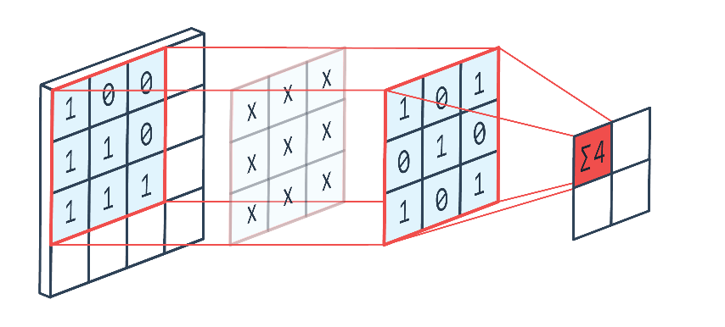
State of the art
Artificial intelligence
Mathematics &
Image processing
Notes:
-5 other works
-2 of them we are going to further analyze

Slide 10

Fast Vision-Based Road Tunnel Detection
M., B., A., B., G., B., & L., M. (2011). Fast Vision-Based Road Tunnel Detection. In Image Analysis and Processing. Berlin, Heidelberg: Springer

Slide 11
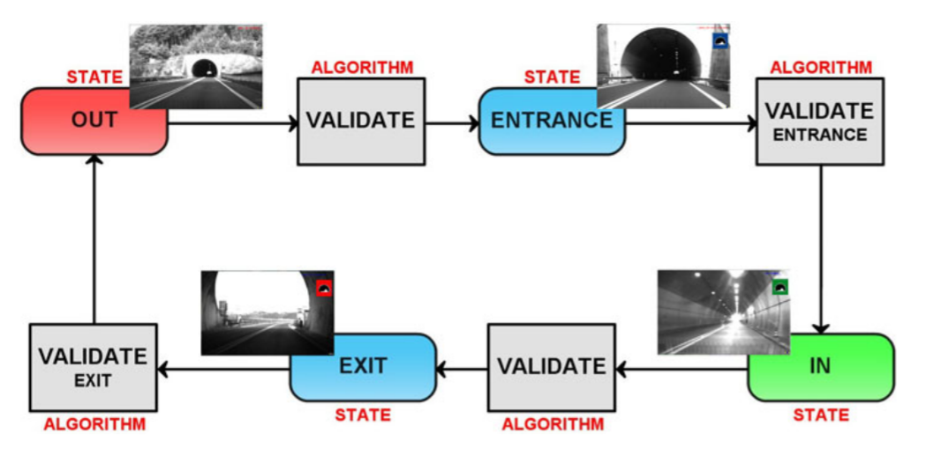
Fast Vision-Based Road Tunnel Detection

Slide 12
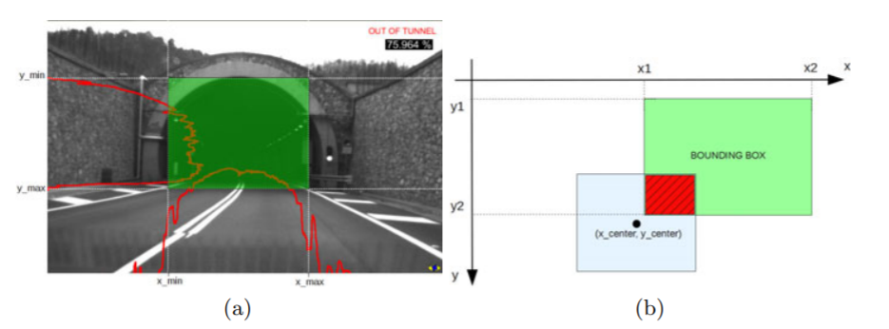
Fast Vision-Based Road Tunnel Detection

Slide 13
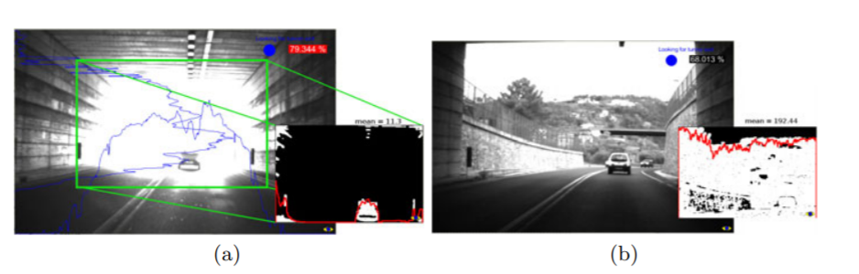
Fast Vision-Based Road Tunnel Detection

Slide 14

Road Tunnel Entrance Recognition System
Christoffer, N. (2009). Road Tunnel Entrance - master thesis. Oslo: University of Oslo.

Slide 15
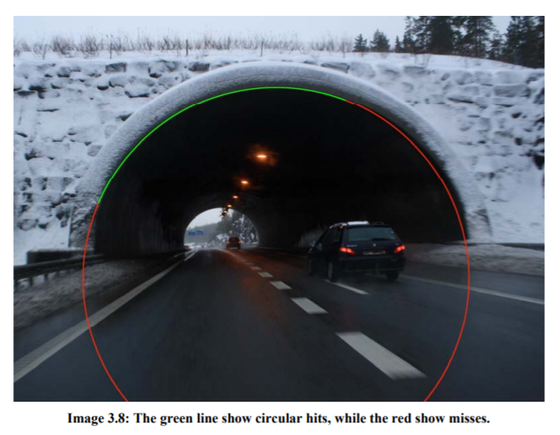
Road Tunnel Entrance Recognition System
Tunnel arch detection

Slide 16
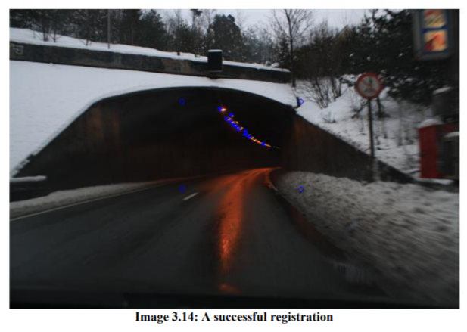
Road Tunnel Entrance Recognition System
Consecutive tunnel lights

Slide 17
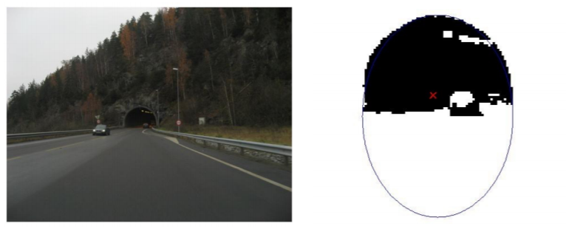
Road Tunnel Entrance Recognition System
Elliptic black hole

Slide 18
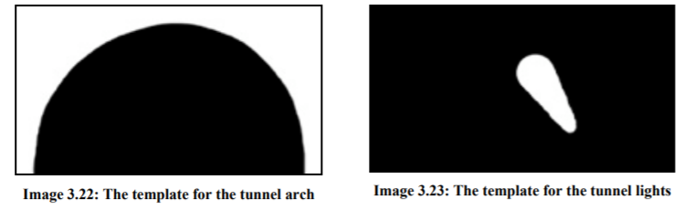
Road Tunnel Entrance Recognition System
Template matching

Slide 19
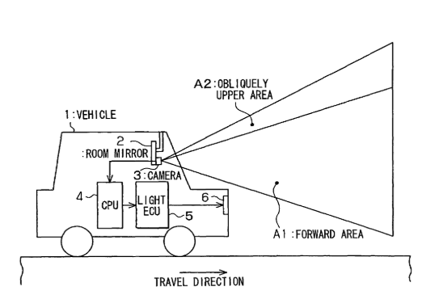
Tunnel detecting device for vehicle
Takeshi, T. (2005-2006). Tunnel detecting device for vehicle and light control device for vehicle. USA: United States Patent Service

Slide 20
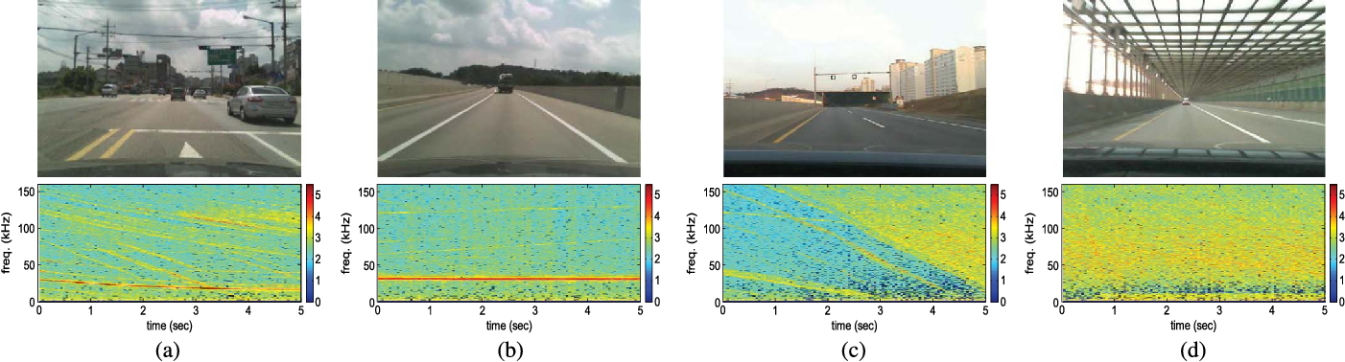
Iron Tunnel Recognition Using Statistical Characteristics of Received Signals in Automotive Radar Systems
Lee, S., Lee, B.-h., Lee, J.-E., Sim, H., & Kim, S.-C. (2018). Iron Tunnel Recognition Using Statistical Characteristics of Received Signals in Automotive Radar Systems. 2018 19th International Radar Symposium (IRS). Bonn, Germany: IEEE.

Slide 21
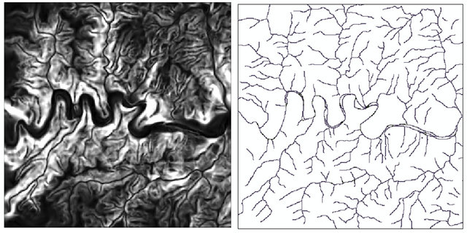
Road and Tunnel Extraction from SPOT Satellite Images Using Neural Networks
Ghasemloo, N., Mobasheri, M. R., Zare, A. M., & Eftekhari., M. M. (2012-2013). Road and Tunnel Extraction from SPOT Satellite Images Using Neural Networks. Journal of Geographic Information System, 6

Slide 22
Architecture
System
Envirronment
Notes:
Because there was very little related work published on this particular subject and I did not intended to analyze work on different object (other than tunnels I mean), I choose to extend a little the research.

Slide 23



system
Shared location
-shared code
-IO files access
The server
Local machine
-image sequences
-computing power
-the IDE
-the display
Notes:
One individual independent project on each component

Slide 24





environment
Anaconda environment on the server
PyCharm IDE
MobaXterm
Notes:
Running the first simple projects on the server
-----
Intelegere mobaxterm
Pregatire environment anaconda, keras
Rulare pe un processor si un gpu
Salvare model si transfer de date dintre pc si server
Folosire tmux , in special sesiuni
Rulare, actualizare automata folosind ide-ul de la pycharm

Slide 25
implementation
Data
Image preprocessing
Project: Data augmentation
Project: Train/Test
Project: Interface
Notes:
Because there was very little related work published on this particular subject and I did not intended to analyze work on different object (other than tunnels I mean), I choose to extend a little the research.

Slide 26
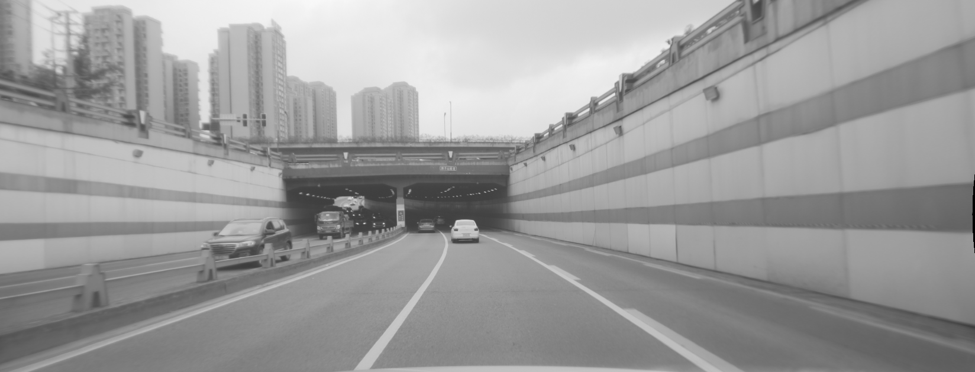
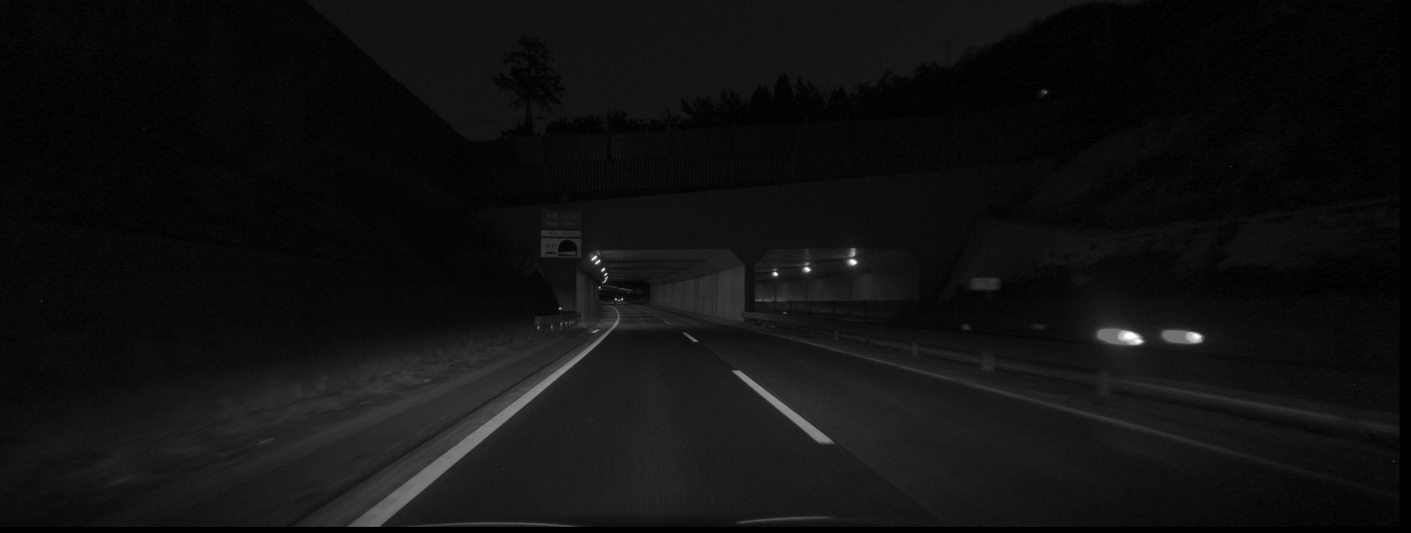
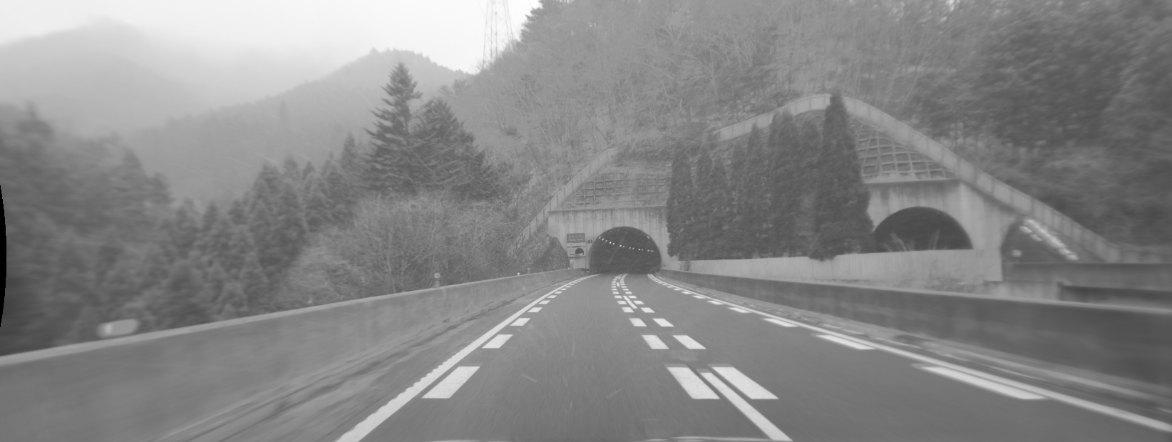
data
PHASE 1 (~18k):
Train ( 11k )
Valid ( 5k )
Test ( 2k )
PHASE 2 (~39k):
Train ( 23k )
Valid ( 11k )
Test ( 4k )
PHASE 3 (~42k):
Train ( 25k )
Valid ( 12k )
Test ( 4k )
Add. Test (30k)

Slide 27
data
PHASE 1 (~18k):
Train ( 11k )
Valid ( 5k )
Test ( 2k )
PHASE 2 (~39k):
Train ( 23k )
Valid ( 11k )
Test ( 4k )
PHASE 3 (~42k):
Train ( 25k )
Valid ( 12k )
Test ( 4k )
Add. Test (30k)
MULTI-CLASS LABELS
BINARY LABELS

Slide 28
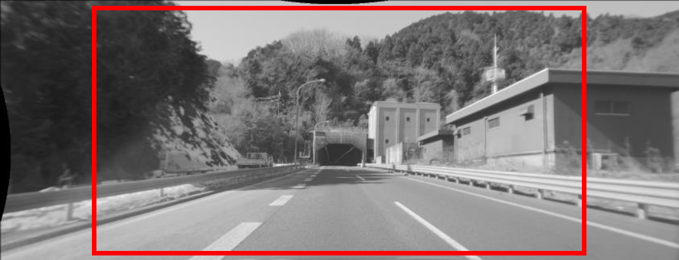
IMAGE PROCESSING
Crop
Resize
Normalize
Brightness
Flip
Shift
Rotate
Saturation
Contrast
Crop
Resize
Normalize
Size: 1200x600
Mean: 0.2814
Std: 0.2478

Slide 29


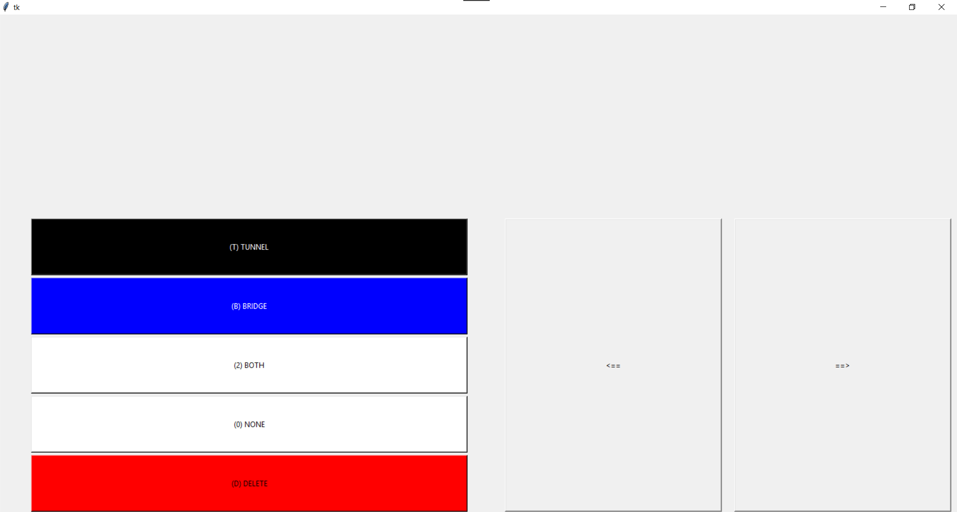


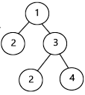
Project: Data augmentation
Shared location
Get paths
Transfer images
Path Conversion
Labelling
Dataset construction
Result extraction

Slide 30
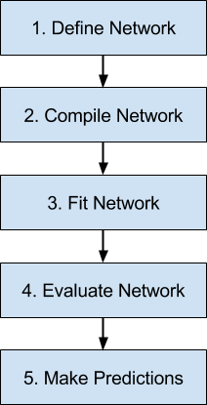
Project: Train/test
The server
MODELS
InceptionV3
ResNet50
DenseNet121
VGG16
DATASETS
Phase 1 (basic)
Phase 2 (augmented, well randomized)
Phase 3 (augmented with special false positives images)
Batch size
Standard deviation
Mean
Image channels
Maximum irbi
Activation function
Parameters
Loss function
Optimizer
No. dense layers
No. epochs
Class weights
Shuffling
Dataset ratios
Random brightness
Random resizing
Random flip
Crop size
Resizing

Slide 31
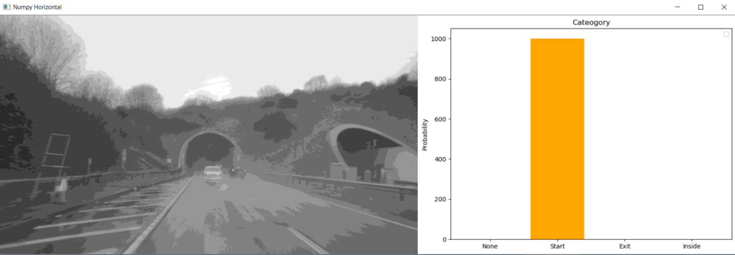
Project: interface
Local machine

Slide 32
Model selection
Model comparison
VGG16
Notes:
Because there was very little related work published on this particular subject and I did not intended to analyze work on different object (other than tunnels I mean), I choose to extend a little the research.

Slide 33
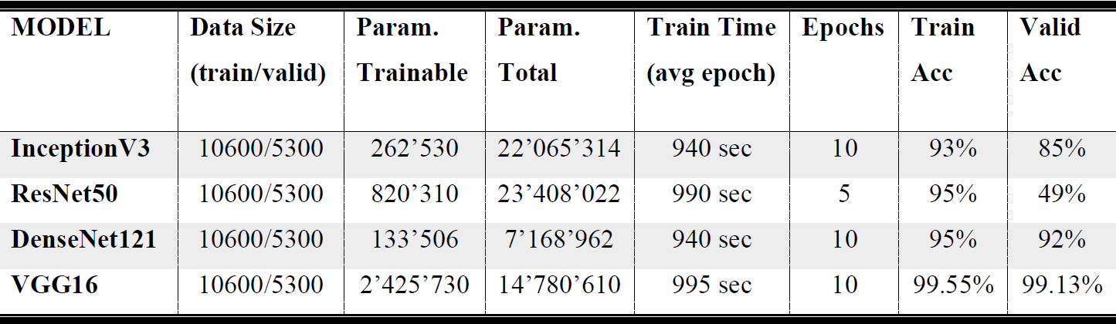
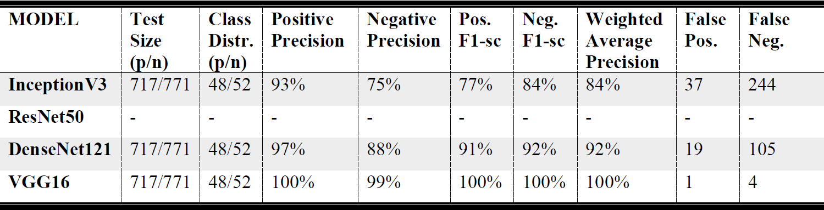
Model comparison
TRAINING PHASE
TESTING PHASE

Slide 34
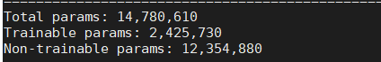
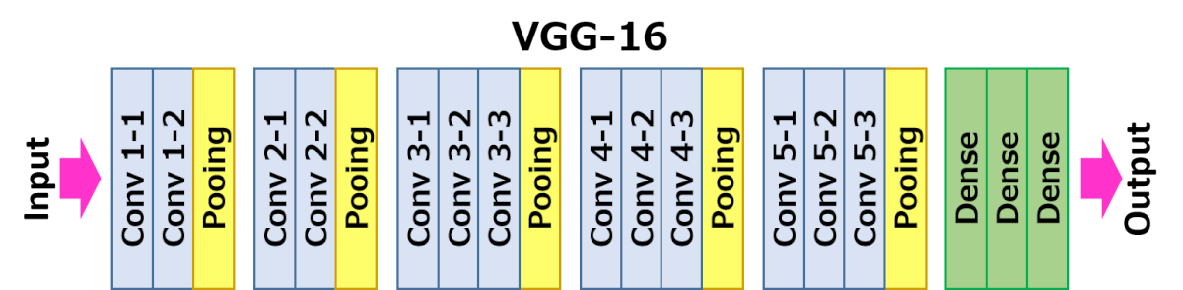
VGG16
Transfer learning
Trained on 1 million images from 1000 classes (ImageNet)
16 main original layers (2 deleted, 3 added and retrained)

Slide 35
techniques
Description
Supervised binary tunnel classification
Supervised binary tunnel classification improvement
Supervised multi-class tunnel classification
Classifications comparison
Active learning strategy
Notes:
Because there was very little related work published on this particular subject and I did not intended to analyze work on different object (other than tunnels I mean), I choose to extend a little the research.

Slide 36
description
CLASSIFICATION
ACTIVE LEARNING
TUNNEL
BRIDGE
ENSEMBLE LEARNING
1.MULTIPLE
(start/inside/exit/none)
2.BINARY
(tunnel/no tunnel)
3.BINARY
(bridge/no bridge)
4.MULTIPLE
(on top/under/none)
TUNNEL & BRIDGE
5.TERNARY
(tunnel/bridge/none)
6.MULTIPLE COMBINED
(start / inside/ exit of tunnel)
(bridge/none)

Slide 37
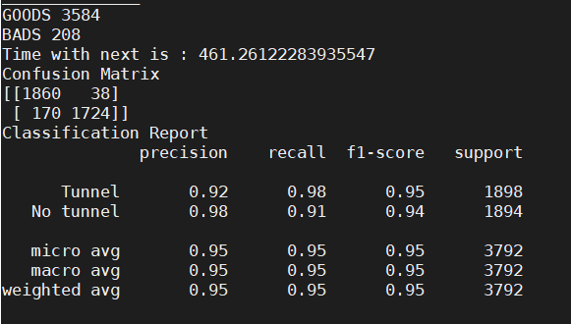
Supervised binary tunnel classification
DATA: Phase 2 (augmented, well randomized)
LABELS: 0 – No tunnel
1 – Tunnel

Slide 38
Supervised binary tunnel classification improvement
DATA: Phase 3 augmented with special false positives images)
LABELS: 0 – No tunnel
1 – Tunnel
+ 2500 images of bridges
Notes:
We observed where the false positives are using the visualization technique
Most of them appeared in 3 situation, one of which was while passing under bridges

Slide 39
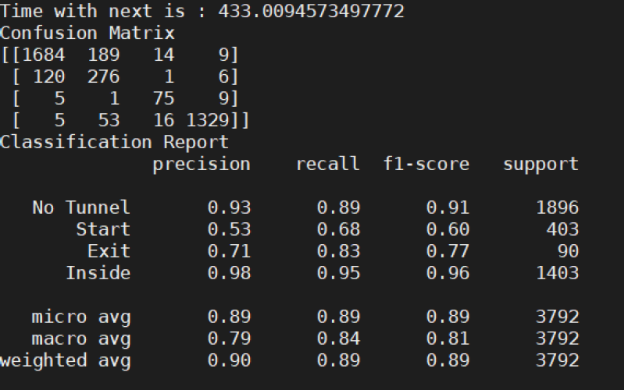
Supervised multi-class tunnel classification
DATA: Phase 2 (augmented, well randomized)
LABELS: 0 – No tunnel
1 – Tunnel entrance
2 – Inside the tunnel
3 – Tunnel exit

Slide 40
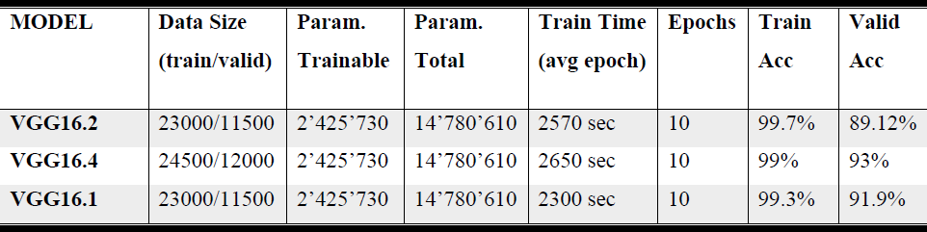
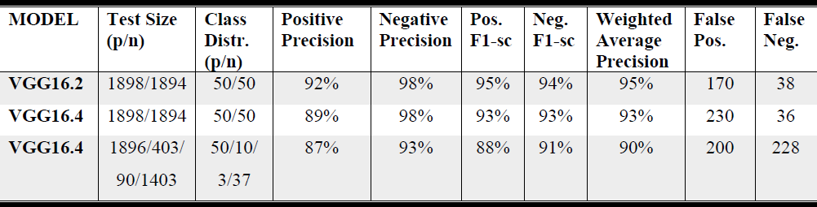
Classifications comparison
binary
binary improve
multi-class
binary
binary improve
multi-class
0.056 seconds
0.095 seconds
0.11 seconds

Slide 41
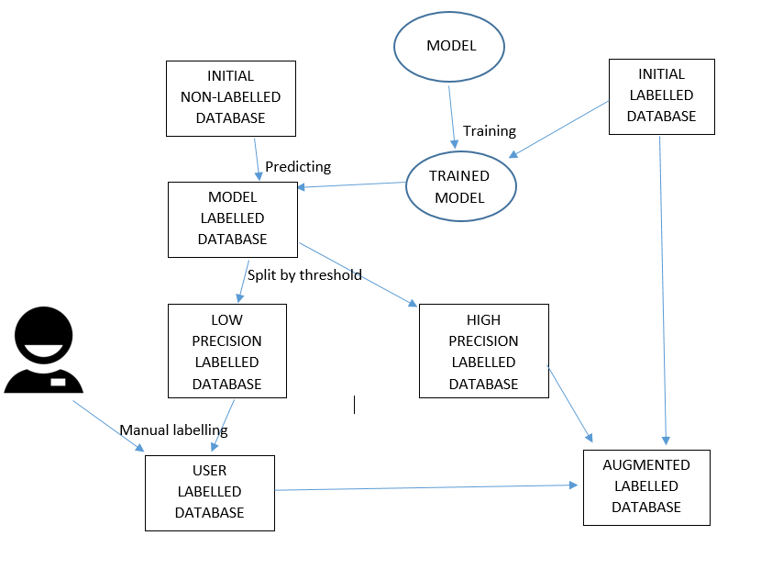
Active learning strategy
Uncertainty sampling

Slide 42
Active learning strategy
5 iterations
100 images/iteration
456 images for validation
24 times faster (training)
225/500 (labelled/total)
6 iterations
900 images/iteration
5746 images for validation
8 times faster (training)
1150/6000 (labelled/total)

Slide 43
conclusion
Other metrics
Comparison to State of the art
Experiments
Limitation
Notes:
Because there was very little related work published on this particular subject and I did not intended to analyze work on different object (other than tunnels I mean), I choose to extend a little the research.

Slide 44
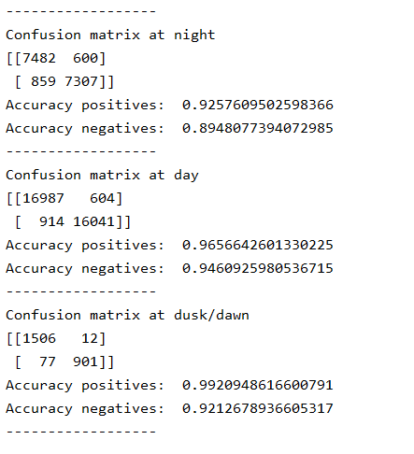
Other metrics
BINARY CLASSIFICATION
BINARY and MULTI-CLASS CLASSIFICATION
30 k images

Slide 45
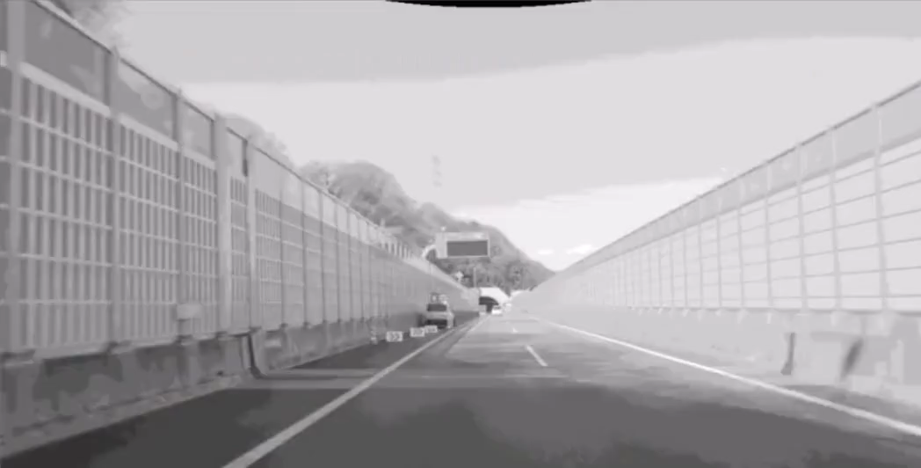
Other metrics

Slide 46

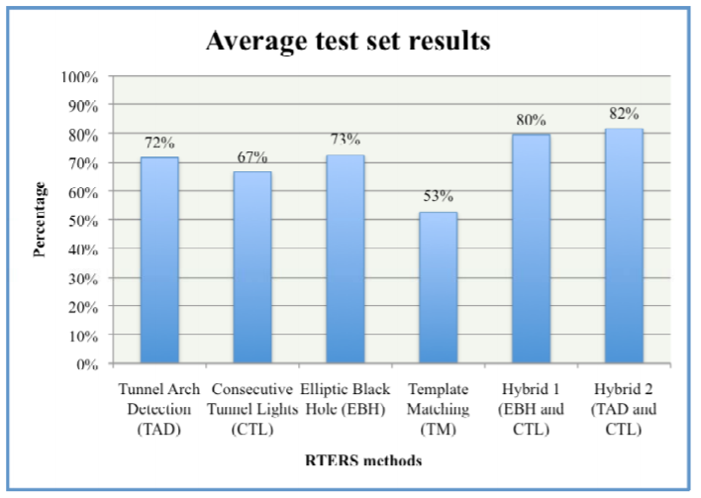
Comparison to state of the art
Christoffer, N. (2009). Road Tunnel Entrance - master thesis. Oslo: University of Oslo.
OUR METHOD
( 1.4 seconds , 1.8 seconds ]- hybrid methods
0.056-0.1 seconds
( 0.5 seconds , 1.2 seconds ]- simple methods
300 images
70.000 images

Slide 47

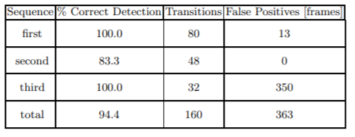
Comparison to state of the art
M., B., A., B., G., B., & L., M. (2011). Fast Vision-Based Road Tunnel Detection. In Image Analysis and Processing. Berlin, Heidelberg: Springer
OUR METHOD
100% TRANSITION DETECTION
~400 transitions
(no tunnel – entrance)
(inside the tunnel – tunnel exit)
0.75 microseconds
0.056-0.1 seconds
50.000 images
70.000 images

Slide 48
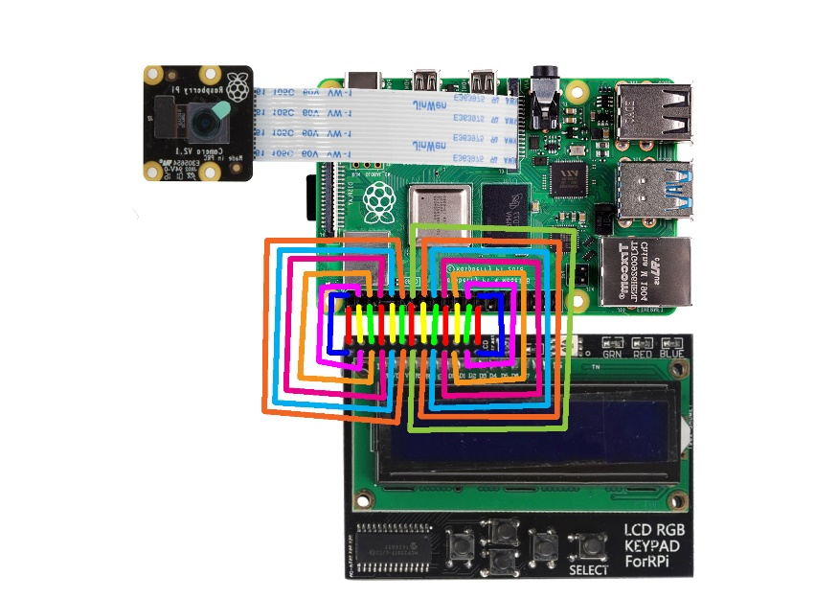
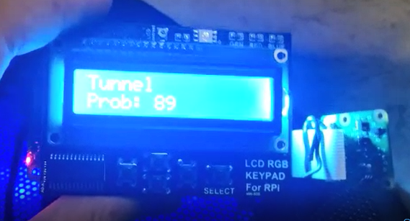
experiments
Raspberry Pi

Slide 49


limitation
Only 10 fps
Labelling process

Slide 50
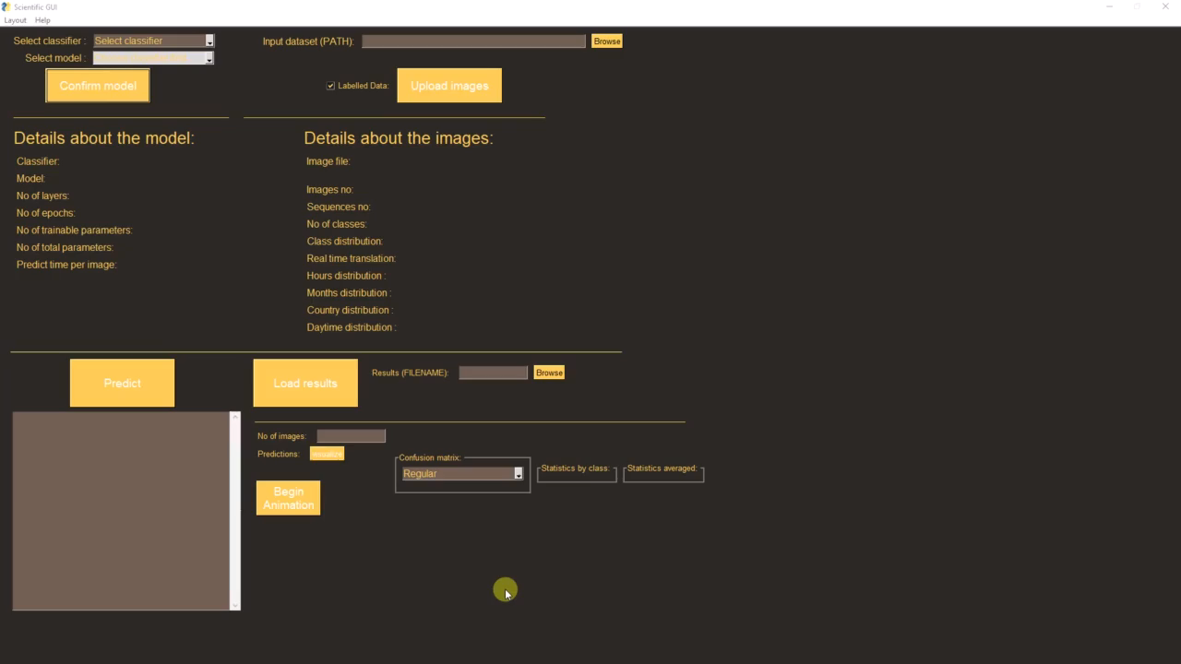
demo

Slide 51

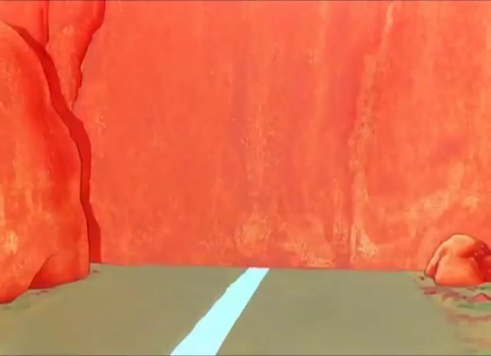
Thank you

